Slide 1
MIS 710 – Process and Innovation Management
5. Framework for Process & Organizational Management
Rummler Framework
Principles of Reengineering
  Rummler: Removal of Disconnects
Six Sigma, ERP: other Process Improvement Frameworks
© J. Morabito and E. Stohr 2020

Slide 2
Systems (Horizontal) View of an Organization
CEO
Research and Development
Manufacturing
Marketing and Sales
Manufacturing Plant
Marketing
Needs
Research
promotions
Customers
Product
specs
Manufacturing Plant
Product Development
designs
Orders
Sales
Manufacturing Plant
orders
Materials
products
Suppliers
Figure 1.3, page 6
Notes:
Note this is a functionally organized organization - as shown at the top.
The departments under each function are shown as boxes.
These are connected by the flow of information/work
The lateral flows that cross the silos ...

Slide 3
Organization as an Adaptive System
  Environmental influences are critical to process innovation…
  e.g., culture is really an enabler of most every thing else.
GENERAL ENVIRONMENTAL INFLUENCES:
      Government, Economy, Culture
Processing System (Organization)
$
Shareholders
Value-added
Processes
Management
Capital
Raw materials
Receiving System
Resources
Technology
Human resources
Products/ services
Orders
Market
Products/ services
Competition
Fig 1.5
Notes:
“Super system map” -
Note that management is there to provide guidance
The value added processes for different companies will be different. Note - each of the yellow process boxes will open up to reveal sub processes.
Note internal feedback loop(s)
But also a feedback in the form of Orders from the external market.

Slide 4
Sources of Organizational Failure
Lack of clear strategy (“goals”)
Failure to manage the organization levels of performance
(goals, design, management)
Lack of good process/work design (hence, “design”)
Quality goals not designed at the process level, only at the
function level (e.g., engineering quality program,
manufacturing quality program)
Failure to manage the white space function/structure
interfaces)
(Rummler p. 34.)
Notes:
“Good people can’t overcome poor systems”

Slide 5
Key Principles See Figure 4.1, p.33
An organization is organized primarily by functions or departments thus necessitating management of the “white space on the organization chart”
The organization may be viewed as a system (as opposed to a series of “stove pipe” functions)
  an organization consists of recursive layers of systems… see page 33
The system consists of three levels of performance
  Organization, Process, Job
Each level has three levels of performance needs
  Goals, Design, Management
The resulting 9 performance variables can be managed
Notes:
See Figure 4.1, p33

Slide 6
THE NINE PERFORMANCE VARIABLES
The end result of the Rummler approach is a well-articulated
specification of each of the nine “variables” in the boxes:
THE THREE PERFORMANCE NEEDS
Goals Design Management
Organization Organization Organization Organization
Goals Design Management
Process Process Process Process
Goals Design Management
Job/Performer Job Job Job
Goals Design Management
THE THREE
LEVELS OF
PERFORMANCE
Pg. 16 Table 2.1
Notes:
Process design is at the center of the design approach - links everything!
Anything missing?
Note that all of the variables implied by the chart exist, de facto, in any organization - they are usually not all explicitly designed. Nor are they coordinated to the degree needed for achievement of the strategic goals of the organization.

Slide 7
Levels of Understanding
The 3 Levels of Performance are really decompositions of each other: Organization, Process, Job
Functional departments are the traditional decomposition
Observations on the 3 Performance Needs
  Goals ---> strategy “WHAT” -→ strategy & goals
  Design ---> realization “HOW” -→ (production) process that is the focus of our reengineering effort
  Management ---> “SUPPORT” (monitoring and resource management) -→ management processes
Goals Design Mgmt
Generally, design from top left to bottom right (see later)
Org
Process
Job
Notes:
Environment (industry, country, culture, etc,) imposes a number of invariants
For example, the solution to the hospital example could not occur in the USA
Generally work from top down … loops possible … but don’t start the work and then try to figure out why you are doing it!

Slide 8
Performance Needs/Variables
Organization Level
Organization Goals
  outcome of a business strategy
  a statement of WHAT the organization will do
Organization Design
  design of the organizational structure and functional (department) relationships
  a statement of HOW the organization is structured
Organization Management
  supplying resources and monitoring performance
  goal management: functional goals, process goals and sub-goals
  process interface management ---> managing the white space of org structure
  monitoring & execution
Notes:
Goals must be reestablished ... see Demming on p.36 & p. 40 (reestablish goals)

Slide 9
Performance Needs/Variables
Process Level
Process Goals
  linked to organization goals (process-specific goals: decomposition of org goals)
  linked to customer requirements as well as organization goals
  linked to benchmarking … to establish metrics and performance targets
  distinguish between customer-facing and internal processes
  functional goals are finalized: the key question is “how well do the functional goals and organizational structure support the process?
Process Design
  the structuring of processes
  work flow design
  IS and SHOULD MAPS
    may “map” other artifacts of design, such as location (important for “co-location”)
Process Management
  same as for organization: sub-goals (linked to functional sub-goals), resource allocation, monitoring performance, and process interface management
Notes:
Bench marking is relevant
The approach is more suited to structured “workflow” processes rather than to non-routine processes

Slide 10
Performance Needs/Variables
Job/Performer Level
Job/Performer Goals
  linked to process goals (job-specific goals: decomposition of process goals)
Job/Performer Design
  the structuring of jobs
  identifying job roles, responsibilities, and boundaries
  identifying necessary skills
Job/Performer Management
  performance
  task support (e.g., resources, priorities)
  consequences (i.e., rewards for achieving the job goals)
  feedback (i.e., do the performers know they are meeting the job goals?)
  skills and knowledge
  individual capacity (physical, emotional, intellectual)

Slide 11
Missing Elements (Performance Needs)
Analysis
Implementation
Goals Design Management
Organization Organization Organization Organization
Goals Design Management
Process Process Process Process
Goals Design Management
Job/Performer Job Job Job
Goals Design Management
Information Technology
Notes:
The Rummler methodology provides a specification of everything that is the output of the analysis and design process.
The methodology does not show what specific changes might be made in the organization (contrast the Principles form last week).
Rummler provides a Process and a Data Model for Org/Process design.
Including a design of the way the whole organization is to be managed.

Slide 12
Process Change
Goals Design Mgmt
SHOULD
IS
Goals Design Mgmt
Org
Process
Job
#1
#6
#8
Org
Process
Job
#3
#2
#5
#7
#4
#9
#10
#11
Information Technology
Information Technology
Changing the IS to the SHOULD process (cell #4 to cell #5) is where the reengineering transformation takes place. This is driven by the organization’s goals (cell #1).
The other cells of the SHOULD matrix are instantiated to support the goals and process of the org.
Input to this transformation (cell #4 to cell #5) is as follows:
  requirements of new goals (cells #1 & #2); org & process goals (benchmarking metrics)
  apply transformation principles:
    removal of disconnects (Rummler)
    application of IT (Davenport)
    reengineering principles (e.g., Hammer, Keen) – e.g., case work
    application of IT as an enabler of a principle or principles of reengineering – e.g., bandwidth, workstations, integrated data model, etc. (Davenport)
The change process may be radical or incremental. You may design radically (transforming cell #4 to cell #5), but implement the change incrementally.

Slide 13
Removal of Disconnects (Rummler)
Removal of disconnects -→ streamlining a process
Driven by manipulation of inputs and outputs
Leads to “Logicalizing” a process, such as:
  Identifying and eliminating duplicate work
  Identifying and eliminating illogical steps
  Identifying and inserting missing steps
  Identifying and eliminating extraneous steps (not supporting the goals)
But, isn’t this really the every-day job of managers, isn’t “removal of disconnects” an on-going management process?

Slide 14
Data Model of an Organization
We can think of the organizational specification as populating the entities and relationships below (as well as others not depicted) with data. e.g., the Organization Entity has goals and a structure plus performance metrics that need to be specified.
Organization
1
M
N
Processes
M
N
M
1
Functions/Departments
M
1
Jobs
M
Cf. Pg. 67 Fig 6.2
Notes:
Organization designs usually skip the process component - concentrating on the departments/functions.
Possibility of building a CASE tool

Slide 15
Organization Goals
At the organizational level, goals are strategic.
Usually goals are stated quantitatively in terms of how well products or services are expected to do in their markets
Goals may be derived from industry CSFs, benchmarking info, competitive information
Note: Balanced score card approach drives goals down through the organization to functions and processes
Example Goals: market share increase, number of new products, reduce cycle time (specific times), accuracy rates, generate specific financial targets.
Notes:
Quality should be at the process level
BSC - balanced scorecard approach is recommended
E.g. goal - increase market share by 20% in 2 years

Slide 16
QUESTIONS FOR ORGANIZATIONAL GOALS
Has the organization’s strategy/direction been
articulated and communicated?
Does this strategy make sense in terms of external
threats and opportunities and internal strengths and
weaknesses?
Given this strategy, have the required outputs of the
organization and the level of performance expected
from each output been determined and communicated?
Pg. 36

Slide 17
Organization Design
Organization Design has two main outputs (see p. 37- 38)
  Organization Chart - focuses on hierarchical reporting relationships
  Relationship Map - focuses on relationships between functions
There should be correspondence between the functions on the relationship map & the functions on the organization chart
Questions:
  Are all the relevant functions in place?
  Are there unnecessary functions?
  Is the current flow of inputs and outputs between functions appropriate?
  Are there disconnects?
  Does the formal structure support the strategy?
The Org Chart and Relationship Map are designed jointly to eliminate problems - old departments may be eliminated or merged, etc. based on streamlining horizontal flows.

Slide 18
Computec, Inc., Organization Chart
President
Product Development
Field Operations
Financing
Human
Resources
Manufacturing
Marketing
Production Control
Copying
Assembly and Shipping
Consulting and Systems Design
Sales
Pg. 37 Fig. 4.2
Notes:
Explain geographic - need to move down to the correct functional level

Slide 19
Relationship Map for Computec (partial)
New product specifications
Product/service promotion
Labor Markets
Human Resources
MARKETING
FIELD OPERATIONS
Staff
Consulting and Systems Design
Needs and applications
Research Community
technology
PRODUCT DEVELOPMENT
Custom software and support
Consulting and custom software
Sales forecast
Sales
Software orders
leads
M
A
R
K
E T
Capital Markets
capital
Generic software
invoices
FINANCE
cash
Orders/contracts
Material needs
softwareorders
Production forecast
MANUFACTURING
Production Control
Copying
Assembly and Shipping
Software packages
Vendors
Blank diskettes and Packaging
Pg. 36 Fig. 3.3
Notes:
Note the external Market relationships are not shown here (see Rummler)
All the same functions are here as in the organization chart - we show the flow between them in the Relationship Map.
Organizational goals are outside the box driving everything….
As we see later, we can now examine functional goals at each level ….
A disconnect here might be the fact that there is no feedback of information from filed operations to the market
Other problems might be convoluted process flows that don’t meet org. goals for cycle time.

Slide 20
Relationship Map Disconnects
No feedback from field operations/sales to marketing!
Where is market research?
Where is customer service?
Orders go through sales and finance before production
Production forecasts are done by finance

Slide 21
Organization Management
Four Dimensions of Organizational Management
1. Goals - Establish functional goals (sub-goals) that support the organization goals
2. Performance - monitor environment and process, measure performance, feedback control, reestablish goals
3. Resources - allocate resources - people, equipment, and budget
4. Interface - harmonize the inputs and outputs of functions and processes. The job of second level and above managers - manage the white space - guided by the relationship map.
Question summary:
  Have appropriate functional goals been set?
  Is relevant performance measured
  Are resources appropriately allocated?
  Are the interfaces between functions being managed?
Notes:
Keep looking back at prior steps
1st level managers inside box, 2nd level ...

Slide 22
Process Level
What is a process?
  a series of tasks that produce a product or service
  some may be wholly within a function, but most are cross-functional
  primary processes: result in a product or service received by an external customer
  support processes: produce products or services that are not visible to an external customer, but necessary to the operations and management of an organization
  management processes: support processes performed by managers (or software)
Why process?
  a process is the set of value adding activities in an organization…responsible for the development and delivery of products or services… determines customer satisfaction, success or failure, etc.
  the process categories are taken directly from Porter’s value chain
Notes:
The above classification of processes is based on the Porter value chain model ...

Slide 23
Examples of Business Processes
Generic Primary Processes
Industry-Specific Primary Processes
Generic Support Processes
Generic Manage-ment Processes
Business generation
Product/service development and introduction
Manufacturing
Distribution
Loan processing (banking)
Claim adjudication (insurance)
Grant allocation (government)
Merchandise return (retail)
Formal strategic and tactical planning
Budgeting
Recruiting
Training
Strategic and tactical planning
Goal-setting
Resource allocation
Human performance management
P.44, Table 4.1
Notes:
Look at the “generic” processes... what does this suggest?
It is possible to use generic process models and possibly 3rd party vendor designs, or even products (e.g., Accounts Payable … this leads to vendor supplied ERP) …
Be careful: “generic” processes may be identity processes (e.g., airplane operations at Fedex.)

Slide 24
Process Goals
The process exists to make a contribution to one or more organizational goals. This is how processes should be designed and measured.
Often process goals correspond to customer requirements.
In most companies: functions/departments have goals ... but processes don’t. (e.g., The billing department has goals but the billing process (which extends beyond billing dept) does not.)
Question: Are the key processes linked to customer and organization requirements?
Notes:
Generic processes are for sale - e.g., ERP
Note these can be priority processes (e.g., Fedex airlines)
Most companies do not have process goals - they have organizational and functional goals ..

Slide 25
Process Design
Process Design is at the “heart” of organizational design.
Build IS and SHOULD Process Maps (note these have already been introduced in the context of organizational design.)
Steps to build a Process Map:
  Identify associated functions, departments, and/or disciplines
  Band them horizontally (along the y-axis)
  Identify the process tasks by identifying inputs and outputs
  Trace the processes as the flow moves through the functional bands
  Observe shared tasks … suggests communication (meeting) or a collaborative workflow system
Notes:
The objective is to achieve the process goals …

Slide 26
Process Design Approach
1. Identify all disconnects on the IS Process Map:
  Illogical steps
  Missing steps
  Extraneous steps
Disconnects address process integration & design. For example:
  Sales reps take too long to enter orders - note: time & motion studies
  There are too many entry and logging steps
  Steps that could be done in parallel are done in sequence
  Some processes should use the Triage principle
  [“IS” versus “SHOULD” - In-class exercise]
2. Develop a SHOULD Process Map to eliminate the disconnects.
Note: This approach is directly suited for continuous improvement. For more radical change (BPR and process innovation), where we completely reconfigure a given process, we need to factor in IT and our imagination as designers, as well as continuing to work with the IS and SHOULD maps … e.g., hospital example used IT to promote significant change)

Slide 27
Computec Order-Filling: A “Should” Process Map (Process Vs. Dept)
CUSTOMER
Order generated
order
SALES
Order Completed
Order Submitted
FIELD OPERATIONS
SALES ADMINISTRATION
order
yes
ORDER ENTRY
Order entered
New Customer?
FINANCE
No
CREDIT AND INVOICING
PRODUCTION CONTROL
Order received
Inventory Adjusted
PRODUCTIONS
COPYING
ASSEMBLY AND SHIPPING
order
Fig. 4.2

Slide 28
Process Management
1. Process goals must be linked to organizational goals
Establish process sub-goals after each step, particularly if critical to the overall process goals. e.g., in mfg, use statistical process control tools (control charts)
Establish functional goals: the purpose of a function is to support a process.. The Process Maps identify process ownership and link process sub-goals to functional goals (see next slide)
Establish the Functional Goals Summary for a given process (see below)
Notes:
Achieve the process goals - see call-outs … Page 61

Slide 29
Process Management (ctd.)
2. Performance Management - monitoring and feedback against the process and functional goals.
  Note that Workflow Management Systems are ideal for performance measurement. Also, ABC Accounting provides the theory.
  Designate a process owner & a permanent cross-functional team.
  Hold monthly reviews.
  Reward people based on reaching process goals
3. Resource Allocation - allocation of funds and people (and technology) necessary to achieve process goals. Allocate $ to functions based on their contributions to processes!
4. Interfaces - Process Maps identify cross-functional linkages to be managed - the “white space”

Slide 30
Selected Process Subgoals for Computec’s Order-Filling Process
CUSTOMER
100% Complete first time
100%
Entered within 24 hrs
Order generated
order
SALES
Order Completed
Order Submitted
FIELD OPERATIONS
SALES ADMINISTRATION
order
yes
ORDER ENTRY
Order entered
New Customer?
FINANCE
No
CREDIT AND INVOICING
PRODUCTION CONTROL
Order received
Inventory Adjusted
PRODUCTIONS
COPYING
ASSEMBLY AND SHIPPING
order
Fig. 5.3

Slide 31
Selected Functional Goals Based on Computec Order-Filling Process Goals
What does the total process and each contributing department need to achieve?
Functional Goals Summary (Measures and Goals)
FUNCTION
Timeliness Quality Budget Other
 | Measures | Goals | Measures | Goals | Measures | Goals | Measures | Goals
TOTAL PROCESS | Percent of orders received by customer within 72 hours of Computec receipt | 95% | Percent of accurate orders | 100% | Average handling cost per order | $3.50 | Percent of bad debt Inventory turns | 1% 12/yr
SALES | Percent of orders entered within 10 hours of receipt | 100% | Percent of accurate orders | 100%
CREDIT & INVOICING | Percent of credit checks done within 24 hours of order receipt | 100% |  |  | Processing cost per order | $0.50 | Percent of bad debt | 1%
Once departmental goals and measures have been established, you can start to allocate resources, identify jobs, budget, etc.
Table 5.2
Notes:
Note again, that “function follows process”
The function is allocated resources on the basis of its contribution to process goals.
Functional goals reflect process goals.

Slide 32
The Human Performance System
“Pit a capable person against a bad system and the system will win every time.”
2. Task Support
1. Performance specifications
INPUT
OUTPUT
CONSEQUENCES
3. Incentives design
PERFORMER
4. Explicit reports & supervisor comments
5. Skills training, individual capability
FEEDBACK
Question:
Are job outputs and standards linked to process requirements which are in turn linked to organization requirements?
Pg. 63 Fig 5.1
Notes:
Performer = individual, group, team

Slide 33
Job/Performer & Human Performance
What is the job/performer level?
  people - regardless of level in the org hierarchy
  groups of people who perform work (convert inputs into outputs)
The Human Performance System -- (see next slide)
  Inputs: raw materials, forms, etc.
  Performers: individuals or groups -- better to distinguish, particularly since there are a variety of structural forms, each of which characterizes a process category
  Outputs: the job/performer goals
  Consequences: the effects that performers experience when they produce an output
    e.g., bonuses, disciplinary action
  Feedback: information that serves to monitor performers
    e.g., error reports
  (see Roles-Responsibility matrix on page 153)
Notes:
Page 153 Roles-Responsibility matrix

Slide 34
Role/Responsibility Matrix - Computec Marketing Function
New Product Development and Introduction
What are the goals and who performs each process step/sub-step within a department?
Marketing Function Marketing Jobs & Responsibilities
Major Process
Steps
Outputs
Goals
Research Analyst
Product Manager
Outputs
Vice President,
•
•
Output
Marketing Outputs
1. New product ideas solicited and formatted for review
New product ideas
Ideas solicited from all
New product
solicited
departments/customer
ideas solicited
for formal review
•
segments
from sales,
Review format follows
software design,
•
guidelines
s
and product
Review each March 1
managers
and
•
September 1st
•
New product idea
All “go” and “no go”
New product
screening, evaluation
evaluations supported by
process team
prioritization facilitated
rationale
convened
•
Priorities consistent with
•
New product ideas
•
strategic needs
•
presented
Final screening within 4
New product ideas
weeks of review
reviewed &
prioritized with
•
•
•
team
2. Product ideas
tested
Product evaluation
Questionnaire meets
Questionnaire
Criteria for questionnaire
questionnaire prepared
validity guidelines
designed
developed; questionnaire
reviewed
Study participants
•
Participants represent all
•
Questionnaire reviewed
selected (jointly with
constituencies
retail sales)
Evaluation conducted
•
•
•
All participants agree with
Participants
Candidates generated
•
decisions
invited to
and reviewed with retail
Evaluation within budget
participate
•
sales
Final participant list
negotiated
Pg. 153 Table 12.5
Notes:
We are decomposing matrix by matrix ...

Slide 35
Interrelating Rummler Cells
Refine Departments (drilling down)
by adding Dept Outputs and Goals (by major Task),
and their respective Job Roles (Title) and Job Outputs
(Do this for each department identified in the Functional Goals Summary
…. thus each Department will have a separate Job/Responsibility matrix)
Functional Goals Summary
Functional Goals Summary (Measures and Goals)
FUNCTION
Timeliness Quality Budget Other
Measures
Goals
Measures
Goals
Measures
Goals
Measures
Goals
1
TOTAL PROCESS
Percent of orders received by customer within 72 hours of Computec receipt
95%
Percent of accurate orders
100%
Average handling cost per order
$3.50
Percent of bad debt
Inventory turns
1%
12/yr
SALES
Percent of orders entered within 10 hours of receipt
100%
Percent of accurate orders
100%
CREDIT & INVOICING
Percent of credit checks done within 24 hours of order receipt
100%
Processing cost per order
$0.50
Percent of bad debt
1%
M
Job/Responsibility Matrix
Job/Responsibility Matrix
Marketing Function Marketing Jobs & Responsibilities
Marketing Function Marketing Jobs & Responsibilities
Major Process
Steps
Outputs
Goals
Research Analyst
Product Manager
Outputs
Vice President,
Major Process
Steps
Outputs
Goals
Research Analyst
Product Manager
Outputs
Vice President,
New product ideas
•
Ideas solicited from all
•
Output
Marketing Outputs
Output
Marketing Outputs
1. New product ideas solicited and formatted for review
solicited
departments/customer
New product
New product ideas
•
Ideas solicited from all
•
New product
for formal review
segments
ideas solicited
1. New product ideas solicited and formatted for review
solicited
departments/customer
ideas solicited
•
from sales,
for formal review
segments
from sales,
Review format follows
software design,
•
Review format follows
software design,
•
guidelines
s
and product
guidelines
and product
Review each March 1
and
managers
•
s
managers
September 1st
Review each March 1
and
New product idea
•
All “go” and “no go”
•
New product
New product idea
•
September 1st
•
screening, evaluation
evaluations supported by
process team
screening, evaluation
All “go” and “no go”
New product
prioritization facilitated
rationale
convened
prioritization facilitated
evaluations supported by
process team
•
Priorities consistent with
•
New product ideas
•
rationale
•
convened
strategic needs
presented
Priorities consistent with
New product ideas
•
Final screening within 4
•
New product ideas
•
strategic needs
•
presented
weeks of review
reviewed &
Final screening within 4
New product ideas
prioritized with
weeks of review
reviewed &
team
prioritized with
2. Product ideas
tested
Product evaluation
•
Questionnaire meets
•
Questionnaire
•
Criteria for questionnaire
2. Product ideas
tested
Product evaluation
•
Questionnaire meets
•
Questionnaire
•
Criteria for questionnaire
team
questionnaire prepared
validity guidelines
designed
developed; questionnaire
questionnaire prepared
validity guidelines
designed
developed; questionnaire
•
•
reviewed
reviewed
Study participants
Participants represent all
Questionnaire reviewed
Study participants
•
Participants represent all
•
Questionnaire reviewed
selected (jointly with
constituencies
selected (jointly with
constituencies
retail sales)
retail sales)
Evaluation conducted
•
All participants agree with
•
Participants
•
Candidates generated
Evaluation conducted
•
All participants agree with
•
Participants
•
Candidates generated
•
decisions
invited to
and reviewed with retail
decisions
invited to
and reviewed with retail
Evaluation within budget
participate
•
sales
•
Evaluation within budget
participate
sales
Final participant list
•
Final participant list
negotiated
negotiated

Slide 36
Job/Performer Goals - Hierarchy
Hierarchy of Performance Goal Setting
Organization goals ---> Relationship Map; Process goals ---> Process map;
Functional goals ---> Relationship Map, Functional Goal Summary
Job goals ---> Role/Responsibility Matrix
Organization Goals
Process Goals
Functional Goals
Job Goals

Slide 37
Job/Performer/Design
1. Allocation of responsibilities among jobs (see Role/Responsibility Matrix)
2. Sequencing of job activities … related to time and motion studies (see Job Model matrix below)
3. Job policies & procedures
  With routine work, job policies & procedures represent most of the information a worker requires, and are therefore sufficient information sources (along with hierarchical referral)
  With nonroutine work, the individual performer’s knowledge and experience, and those of others (in teams) are required information sources. Professional practice also important
  Why is it beneficial to “frame” or “shape” as well as to specify nonroutine processes? Judgement is difficult to specify or automate
4. Ergonomics - enabling the human performance system

Slide 38
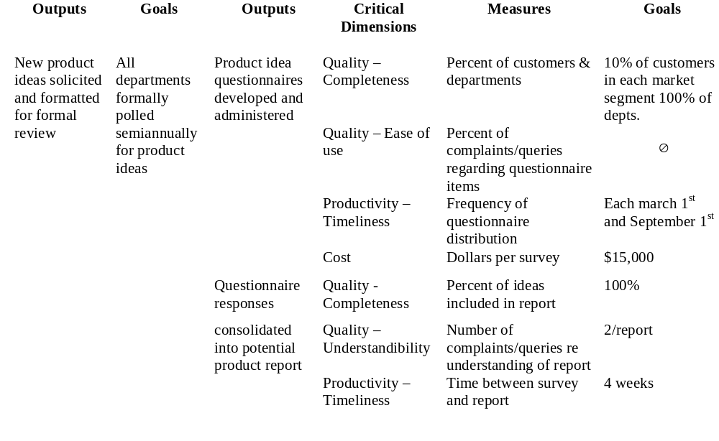
Portion of a Job Model for the Computec Market Research Analyst
Marketing Department Market Research Analyst
Pg. 154 Table 12.6
Notes:
Specification for job for first marketing output

Slide 39
PCI Claims Supervisor Job Model
JOB: Claims Supervisor
JOB PURPOSE: Claims Processing
ACCOMPLISHMENTS SUBACCOMPLISHMENTS | CRITICAL DIMENSIONS | MEASURES | STANDARDS
CLAIMS QUALIFIED Loss notice received Claim type identified Coverage determined Recovery potential identified Legal trends identified & considered Missing/inaccurate information identified Claims progress tracked | Accuracy Timeliness | Percentage of cases of recovery potential identified Percentage of coverage issues identified later Percentage of loss notices entered in correct claim category Average loss notice processing/confirmation time | 75% of cases of recovery potential identified Additional or corrected coverage issues identified in less than 5% of cases All loss notices entered. Loss notice entries reported by claim category 15 minutes per loss notice
This is another example of a Job Model (for a supervisor)
Table 9.3

Slide 40
Interrelating Rummler Cells
Job Model
Marketing Department Market Research Analyst
Job/Responsibility Matrix
Marketing Function Marketing Jobs & Responsibilities
Major Process
Steps
Outputs
Goals
Research Analyst
Product Manager
Outputs
Vice President,
New product ideas
•
Ideas solicited from all
•
Output
Marketing Outputs
1. New product ideas solicited and formatted for review
solicited
departments/customer
New product
for formal review
segments
ideas solicited
•
from sales,
Review format follows
software design,
•
guidelines
s
and product
Review each March 1
and
managers
New product idea
•
September 1st
•
screening, evaluation
All “go” and “no go”
New product
prioritization facilitated
evaluations supported by
process team
•
rationale
•
convened
Priorities consistent with
New product ideas
•
strategic needs
•
presented
Final screening within 4
New product ideas
weeks of review
reviewed &
prioritized with
2. Product ideas
tested
Product evaluation
•
Questionnaire meets
•
Questionnaire
•
Criteria for questionnaire
team
questionnaire prepared
validity guidelines
designed
developed; questionnaire
reviewed
Job Model
Study participants
•
Participants represent all
•
Questionnaire reviewed
Marketing Department Market Research Analyst
selected (jointly with
constituencies
retail sales)
Evaluation conducted
•
All participants agree with
•
Participants
•
Candidates generated
•
decisions
invited to
and reviewed with retail
Evaluation within budget
participate
•
sales
Final participant list
negotiated
1
M
Refine Job Role (drilling down)
by adding (for each Job Output)
its respective Job Dimensions, Measures, and Goals
(Do this for each Job Role identified in a given Job/Responsibility Matrix
…. thus, each Job Role will have a separate Job Model matrix)

Slide 41
Job/Performer Management
Execution of the Human Performance System -- see Figure 6.3, p. 71
1. Performance specifications - “the outputs and standards that comprise job goals”
2. Task Support - design jobs well and then provide resources and a suitable environment
3. Consequences - must support job goals, which are a consequence of process and organization goals
4. Feedback - is the feedback relevant, accurate, timely, specific, easy to understand
5. Skills and knowledge - as required by a job (defined as part of a process)
6. Individual Capacity - employ sufficiently capable people
Extend the Job Model Format:
  Job model format for a claims supervisor is on page 111 (Table 9.3)
  Job analysis worksheet on page 112 (Table 9.4)
  Performance system design worksheet (extension) is on page 113 (Table 9.5)
Notes:
Should we differentiate between skill and knowledge? Is one more appropriate to the context of process, and the other to function?
What are the effects of experience on skill? On knowledge?
Individual capacity - “internal capabilities”

Slide 42
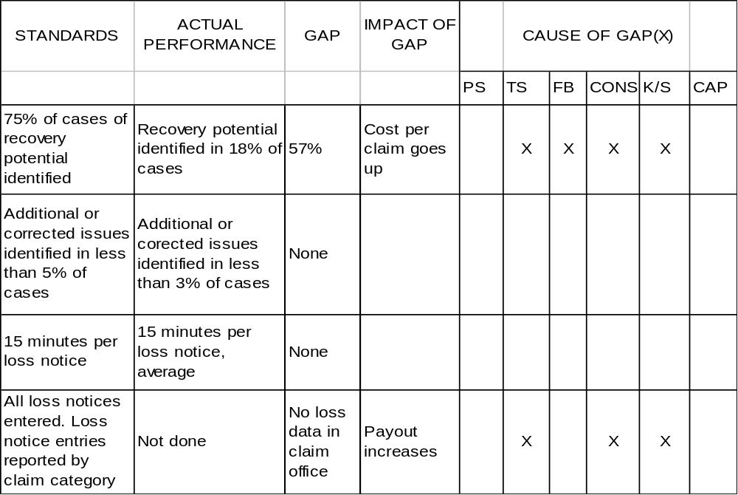
Interrelating Rummler Cells
Marketing Department Market Research Analyst
Job Model
(containing performance objectives
stated in terms of outputs, dimensions, measures, and goals)
Job Analysis Worksheet
(containing actual performance results with cause of each gap)
Objectives Vs. Actual Results: this is the basis of a Performance Review and a plan for Individual Improvement
Refine Job Model
by adding (for each Job Dimension, Measure, and Goal (i.e., Standard))
the actual performance results, the gap (if any), impact of gap, and possible causes of each gap

Slide 43
PCI Job Analysis Worksheet
PS - Performance Specifications
TS - Task Support
FB - Feedback
CONS - Consequences
K/S - Knowledge/Skills
CAP - Capability
Table 9.4

Slide 44
Summary of Artifacts
Goals Design Mgmt
Functional goals
Monitor performance
Resource allocation
Interface mgmt
Org
Process
Job
Org Chart
Relationship map
Strategy
Functional goals
Monitor performance
Resource allocation
Interface mgmt
IS map
SHOULD map
Process goals
Design of Human
Performance System (HPS)
Job Model Format (job design)
Allocate job responsibilities
Sequencing job activities
Hierarchy of
Performance Goal Setting
Goal setting (HPS)
Execution of
Human Performance System
(HPS)
Notes:
This is a summary of the design outputs

Slide 45
Example of Specific Problem Fix
Based on Chapter 9
Org. Performance
Problem Identified
Org. System &
Relationship Map
Identify Disconnects
Improvement opportunities
Improvement Actions at Organizational Level
Select Process to fix
Develop Process Maps (As-is)
Identify Disconnects
Improvement opportunities
Improvement Actions at Process Level (Should-Map)
Select Job(s) to fix
Develop Job
Specifications
Identify improvement opportunities
Improvement Actions at Job Level
Implement All Required Actions
Notes:
Note that improvements can be made at each level independently. The process is more important than simply filling in forms.
Example:
Problem - new products often behind schedule
Organizational Level - Customer Representatives do not understand product specifications -> provide link (feedback to Product design); improve manuals
Process Level - New product development process can be redesigned to eliminate approvals and be more parallel; performance goals and feedback needed (informate)
Job Level - designers need better incentives; currently they are rewarded only for quality, not speed of development

Slide 46
Registration Example
Hardcopy
Program Directors
Program Admin.
Program Admin.
Instructions
Schedule
Registrar Database
Program Admin.
Schedule
Howe Database
Schedule
Registrar Web Site
Students

Slide 47
Fitting Performance Improvement Initiatives Within Rummler
Goals Design Mgmt
SHOULD
IS
Goals Design Mgmt
Org
Process
Job
#1
#6
#8
Org
Process
Job
#3
#2
#5
#7
#4
#9
#10
#11
Information Technology
Information Technology
Example:
When implementing an ERP system remember that you are implementing IT and a SHOULD Process. In effect, cell #5 and its IT component have been instantiated by the ERP vendor. You still need to instantiate the other cells in the SHOULD matrix. Failure to fully instantiate all nine cells will result in a misfit and organizational dysfunction – a common experience with ERP. Therefore, we need a “Design For ERP” framework within which to implement an ERP package. Rummler is one such framework.
Hammer’s KEY for all Initiatives: Integrate performance improvement initiatives (e.g., ERP, six sigma, etc.) under a process management umbrella, such as Rummler, or Hammer’s proprietary framework.

Slide 48
Other Process Improvement Initiatives and their Relationship to the Rummler Framework

Slide 49
Six Sigma
Hammer, M. 2002. “Process Management and the Future of Six Sigma.” Sloan Management Review. Winter 2002. Vol. 43, No. 2
Technically, six sigma is a specific measure of quality: 3.4 defects per million opportunities
  most companies operate at much lower ranges (66K-300K defects/million opportunities)
  some companies do not need to reach 3.4, others need to surpass it
In practice, six sigma has come to mean a set of methodologies and techniques used to improve quality and reduce costs. The most common methodology is DMAIIC.
  DMAIIC: define, measure, analyze, improve, and control
Current research indicates the following key facts about six sigma:
  KEY#1: The power in six sigma is that it is a disciplined approach to coping with complexity. It is particularly effective in solving narrow problems in fundamentally sound business processes.
  KEY#2: Six sigma is a project-based methodology
  KEY#3: When six sigma was applied to large-scale projects, the results were unsatisfactory until the scope was narrowed. (Six Sigma does not scale very well!)
  KEY#4: Six sigma was not aligned with the strategy of the organization as a whole. Individual and aggregate six sigma projects did not contribute to larger corporate goals.
  KEY#5: Six sigma efforts do not address a company’ basic assumptions (business rules) and its functional organizational structure.
The Power of Design for Six Sigma (DFSS) by Subir Chowdhury: Six sigma is a quality-control & production approach focused on existing designs. … need to focus on the design stage (e.g., “80% of all quality problems are unwittingly designed into the product itself”)
  Therefore, use a design framework for six sigma known as IDDOV: Identify and Define the opportunity, Develop the concept, and Optimize the design and Verify it
  Note that the Rummler matrix is another framework within which six sigma may be implemented.

Slide 50
Other Approaches to Performance Improvement
Hammer, M. 2002. “Process Management and the Future of Six Sigma.” Sloan Management Review. Winter 2002. Vol. 43, No. 2
Enterprise Resource Planning (ERP). A family of software modules on a common database. An ERP system is a tool for supporting end-to-end business processes.
  KEY: An ERP = IT + Business Process
Supply Chain Integration. A supply chain is an inter-company business process that crosses corporate as well as functional boundaries.
  KEY: SCM systems supply electronic links for connecting organizations’ value chains
Globalization. Creating a global business means installing uniform business processes for all geographies.
  KEY: Global process owners create uniform processes while country managers implement them
E-Business. Providing outside parties (particularly customers and suppliers) with electronic access to a company’s business process.
  KEY: Easy access to a good business process. Access to a lousy process advertises such
Six Sigma. See next slide.

